Slide 1
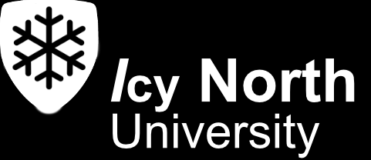


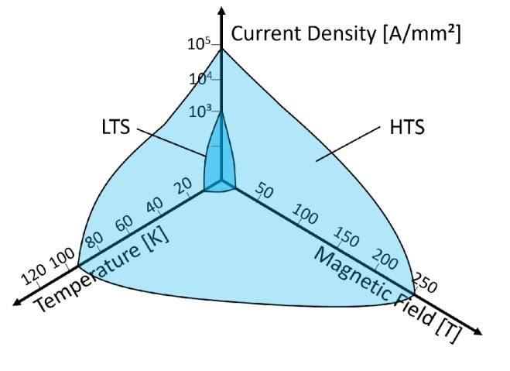
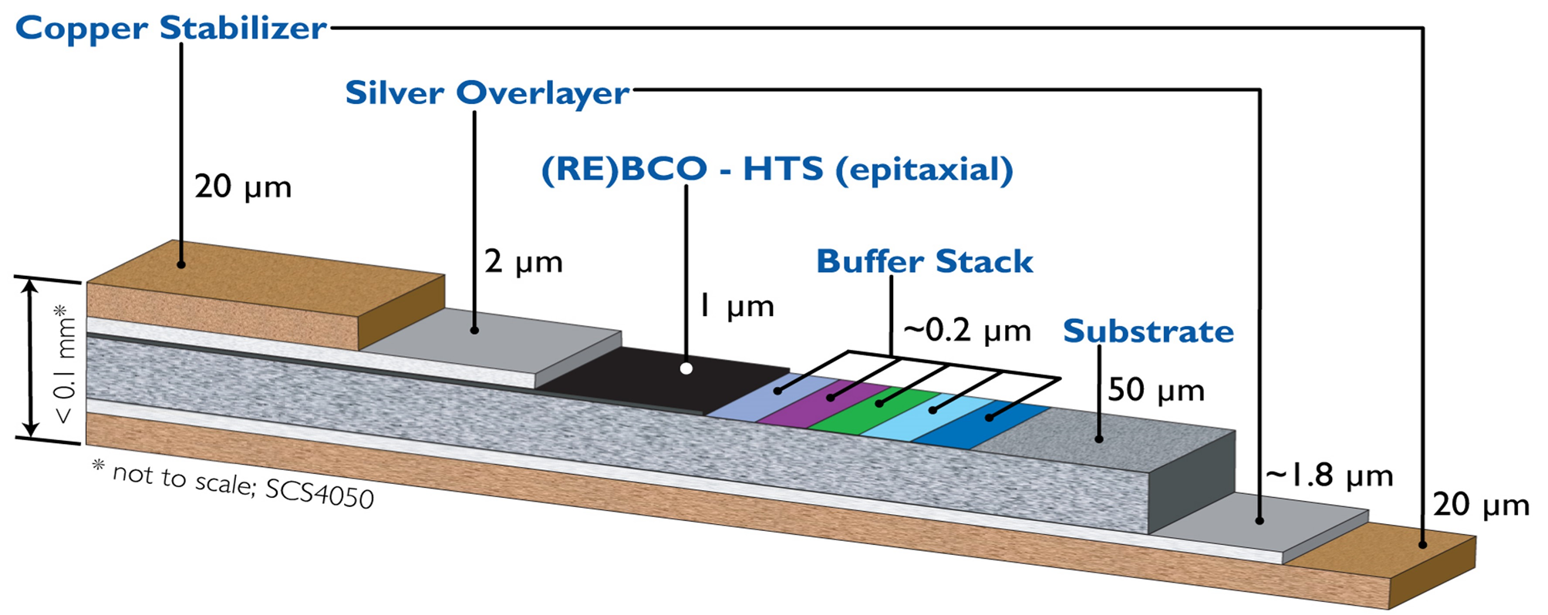
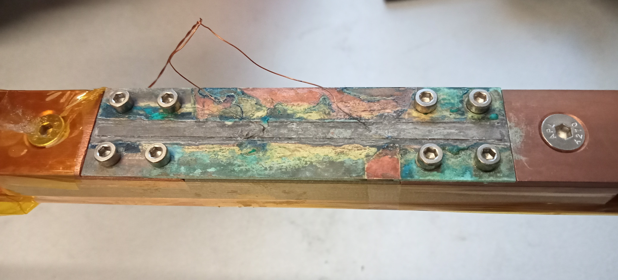
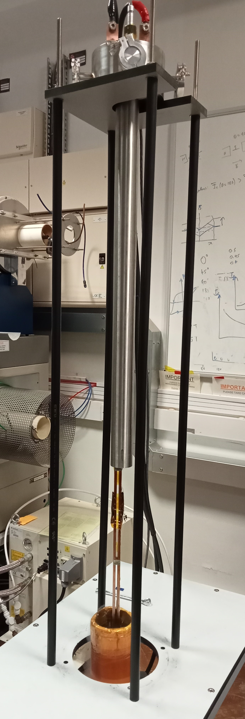
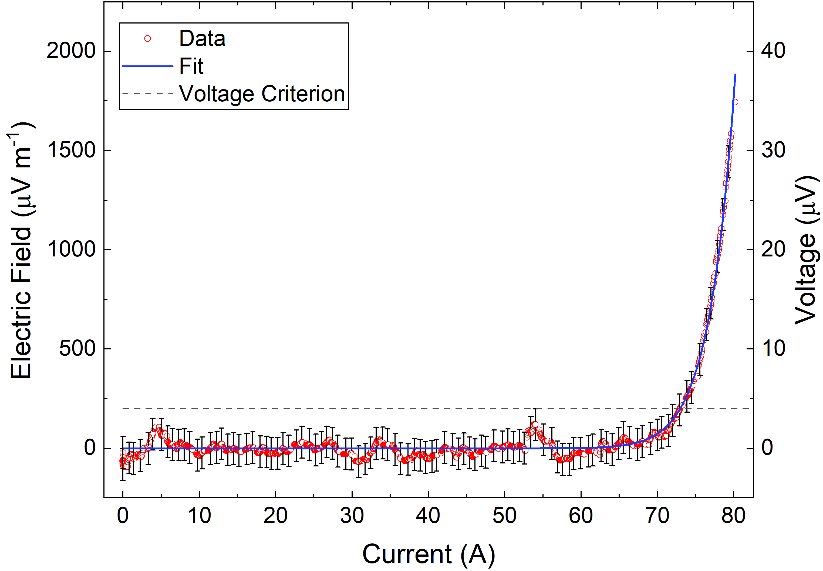
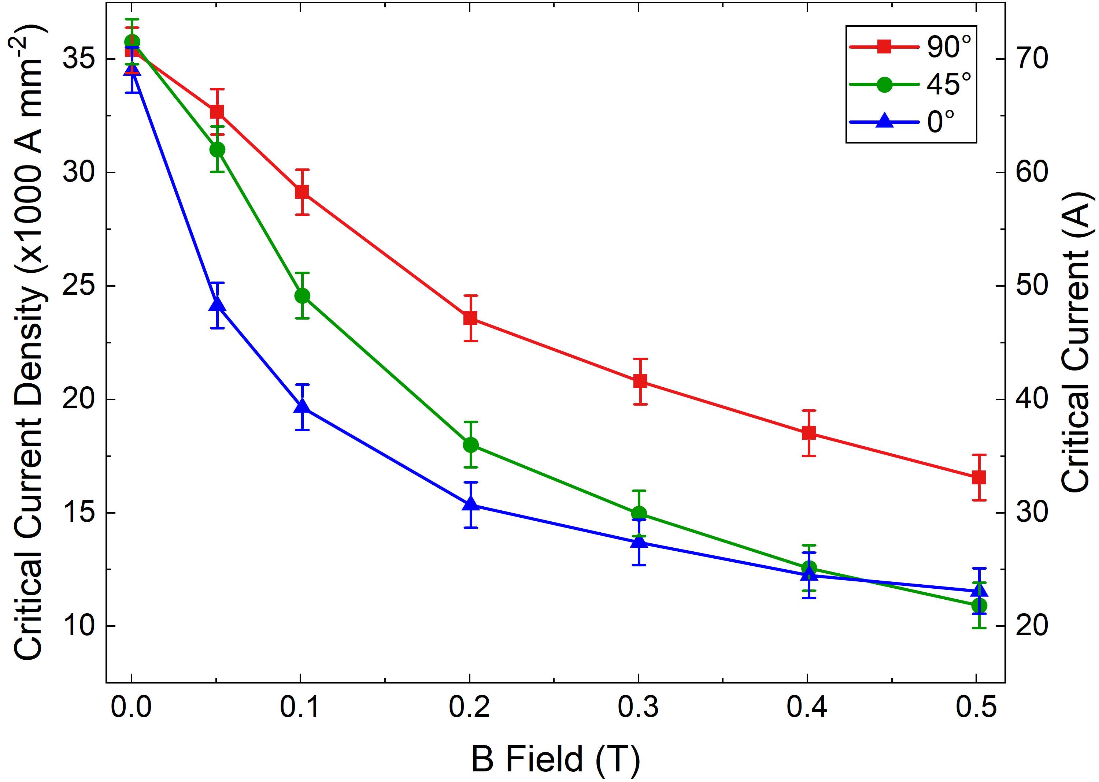

The critical current of HTS superconducting tapes in high fields for fusion
Brad Pitt, Oliver Heaviside and Marie Curie
Centre for Materials Physics, Superconductivity Group
Department of Physics, I_{cy} North University, UK
Background and Motivation
High temperature superconductors (HTS) can carry many orders of magnitude more lossless current density than low temperature superconductors (LTS).
Superconductors can:
Carry large currents with zero resistance.
Be wound into magnets to produce the strong magnetic fields necessary for fusion power [2].
Critical current (I_{c}) is the maximum current superconductors can carry before they become resistive.
In strong magnetic fields, lines of magnetic flux (fluxons) enter the superconductor. If the fluxons are not held in place (pinned) by crystal defects, they will move and produce resistance.
Flux pinning limits the magnitude of I_{c}, a key quantity in the engineering of superconducting magnet systems.
We measured a 2 mm wide tape which contains a 1 μm thick layer of REBCO high temperature superconductor. We intend to characterise and understand the superconducting properties.
Figure1: Critical surface for low and high temperature superconductors [1].
Figure 2: Schematic of HTS REBCO tape, manufactured by Superpower [3].
Experimental Procedure
The HTS tape was soldered to the brass sample holder and voltage leads were soldered on top.
The sample holder was mounted onto the probe and the voltage leads connected to a voltmeter via an amplifier.
The probe was suspended above a Dewar containing liquid nitrogen (at 77 K), which is within the bore of a resistive magnet.
Before each voltage trace was measured, the field is increased to 0.5 T to reduce the effects of magnetic hysteresis in the sample.
A voltage-current measurement was made by increasing the current through the superconductor until it became resistive.
A series of measurements were made at different applied magnetic fields (0 to 0.5 T) and angles between the field and the normal to the tape (0 to 90 degrees).
External current
leads
Figure 3: An HTS sample that had been soldered and mounted onto the probe.
Instrumentation
connection
We made a four-terminal resistance experiment. Current entered via the bus bars through a layer of solder and brass. The insulated copper wires were the voltage taps which had to be located far from the current transfer region [4].
Analysis and Discussion of Results
Busbar
Between the voltage taps, some current passed through the resistive material, leading to a resistive voltage that was subtracted.
The electric field criterion was set to be 400 μV. m⁻¹ , a value well above the noise.
Below the electric field criterion, the sample conducts the current with very low resistance.
The electric-field versus current (E-I) data were described using:
$E=E_{c}{\left(\frac{I}{I_{c}}\right)}^{n}$.
The critical current I_{c} and the index of transition n were determined from fits to the E-I data.
The critical current at 0 T was 73 ±1 A, in good agreement with the manufacturer’s rating.
I_{c} decreases with increasing field due to the greater Lorentz force on the fluxons overcoming the flux pinning force at lower currents.
I_{c} is highest when the magnetic field is applied at 90 degrees to the tape, because of increased pinning due to the non-superconducting planes in REBCO [5].
Nitrogen
Dewar
Figure 4: Experimental setup: The sample was soldered to the lower part of the probe and positioned in the Dewar in the centre of the magnetic field produced by a resistive split-pair magnet. The external current leads were attached to the top of the probe.
Future Work
Measure the angular dependence of I_{c} in magnetic fields in detail to understand how the anisotropy of the tape affects the properties.
Measure the tapes in conditions that are closer to those used in fusion power plants: magnetic fields 14 T to 20 T and temperatures 5 K and
20 K.
Develop a theory that describes the I_{c} data and identify and optimise the flux pinning mechanism that operates in the superconducting tape.
Figure 5: The E-I trace obtained at zero applied field at 77 K after the resistive baseline has been subtracted.
Figure 6: The field dependence of I_{c} between 0-0.5 T with different angles between the tape and the applied field
References & Acknowledgements
[1] Image from Haubner, M. et al, Electron Beam Characterisation of REBCO-Coated Conductors at Cryogenic Conditions. Appl. Sci. 2023, 13, 2765. https://doi.org/10.3390/app13052765 . [2] Raine, M. J., et al. "European Nb₃Sn and Nb–Ti strand verification for ITER: processing, measurements and statistical analysis." Superconductor Science and Technology 38.8 (2025): 085015. https://iopscience.iop.org/article/10.1088/1361-6668/adf3ea/pdf . [3] Image from Super Power Inc., url: http://www.superpower-inc.com/content/2g-hts-wire . [4] Raine, M. J., et al., “Handbook of Superconductivity - Chapter: Characterisation of the Transport Critical Current Density for Conductor Applications.” Taylor and Francis - CRC Press, 2017. https://superconductivitydurham.webspace.durham.ac.uk/wp-content/uploads/sites/226/2024/03/Raine-Keys-Hampshire-sent-Characterisatiof-the-transport-critical-current-density-for-conductor-applications.pdf
[5] Poole, C. P., et al. “Superconductivity.” Academic Press Inc, San Diego, California, 1995. This work is funded by EPSRC grant for the Fusion Doctoral Training Network.
Centre for Materials Physics
https://superconductivitydurham.webspace.durham.ac.uk/

